Slide 1
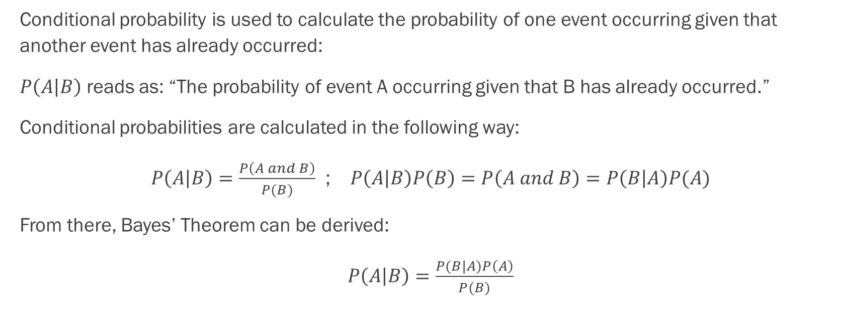
Naive Bayes: Conditional Probability Basics
Conditional probability is used to calculate the probability of one event occurring given that another event has already occurred:
$P\left(A | B\right)$ reads as: “The probability of event A occurring given that B has already occurred.”
Conditional probabilities are calculated in the following way:
$P\left(A | B\right)=\frac{P\left(A and B\right)}{P(B)}$ ; $P\left(A | B\right)P\left(B\right)=P\left(A and B\right)=P\left(B | A\right)P(A)$
From there, Bayes’ Theorem can be derived:
$P\left(A | B\right)=\frac{P(B|A)P\left(A\right)}{P(B)}$

Slide 2
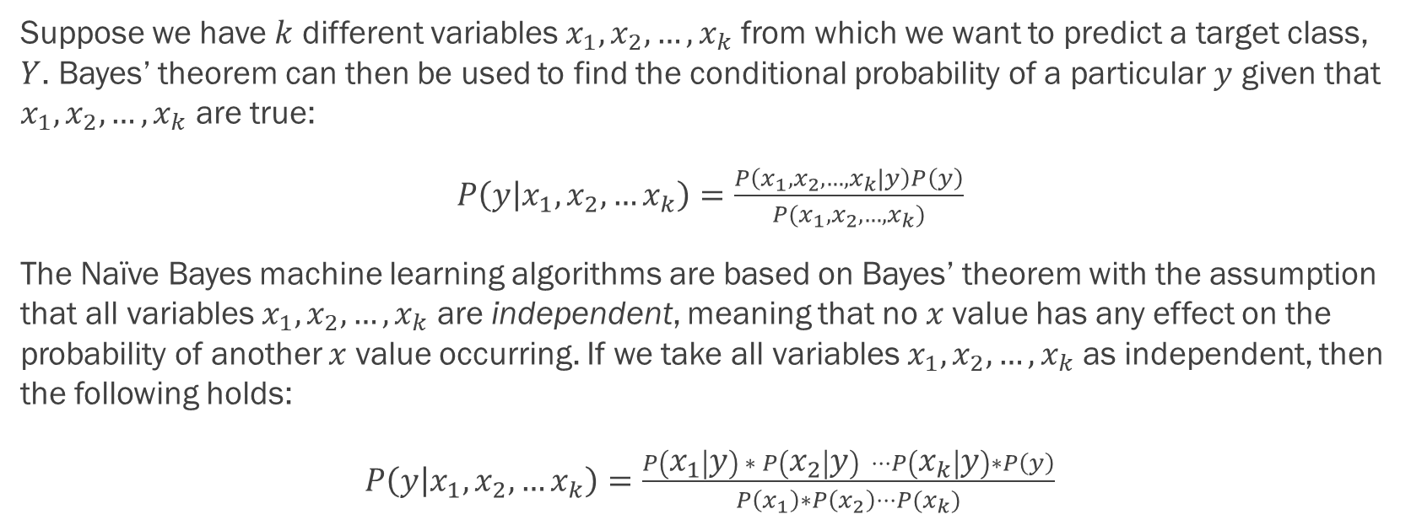
Naive Bayes: The Central Assumption
Suppose we have $k$ different variables $x_{1}, x_{2}, …, x_{k}$ from which we want to predict a target class, $Y$. Bayes’ theorem can then be used to find the conditional probability of a particular $y$ given that $x_{1}, x_{2}, …, x_{k}$ are true:
$P\left(y | x_{1},x_{2},…x_{k}\right)=\frac{P\left(x_{1},x_{2},…,x_{k}|y\right)P\left(y\right)}{P(x_{1},x_{2},…,x_{k})}$
The Naïve Bayes machine learning algorithms are based on Bayes’ theorem with the assumption that all variables $x_{1},x_{2},…,x_{k}$ are independent, meaning that no $x$value has any effect on the probability of another $x$ value occurring. If we take all variables $x_{1}, x_{2}, …, x_{k}$ as independent, then the following holds:
$P\left(y | x_{1},x_{2},…x_{k}\right)=\frac{P\left(x_{1} | y\right) ∗ P\left(x_{2} | y\right) ⋅⋅⋅P\left(x_{k} | y\right)∗P\left(y\right)}{P\left(x_{1}\right)∗P\left(x_{2}\right)⋅⋅⋅P(x_{k})}$

Slide 3
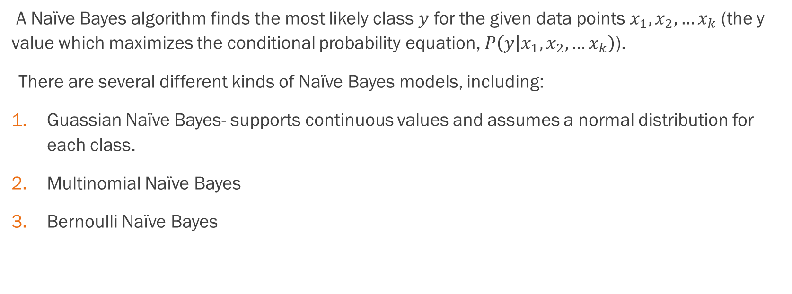
Naïve Bayes:
A Naïve Bayes algorithm finds the most likely class $y$ for the given data points $x_{1},x_{2},…x_{k}$ (the y value which maximizes the conditional probability equation, $P\left(y | x_{1},x_{2},…x_{k}\right)$).
There are several different kinds of Naïve Bayes models, including:
Guassian Naïve Bayes- supports continuous values and assumes a normal distribution for each class.
Multinomial Naïve Bayes
Bernoulli Naïve Bayes

Slide 4
Advantages:
Simple to implement
Fast and effective in predicting the class of datasets
Doesn’t require a large test set to work well
Can handle both discrete and continuous data
Useful for text analysis and classification problems
Can be used for multiple class prediction problems

Slide 5
Disadvantages:
Relies upon the assumption that variables are independent
Not ideal for data sets with a large number of variables
Zero Frequency Problem

Slide 6
What data processing steps does the algorithm require
Convert categorical features to numeric (get dummies)
Handle missing data. Drop or impute
Identify outliers, remove or convert into numbers
Separate dependent feature from independent features
Gaussian- continuous data, need to be distributed normally
Data smoothing- so that no probabilities are completely zero

Slide 7
These are the most commonly adjusted hyperparameters with different Naive Bayes Algorithms
Gaussian Naive Bayes
◼var_smoothing
Bernoulli Naive Bayes
◼ alpha
◼fit_prior
◼binarize
Multinomial and Categorical Naive Bayes
◼ alpha
◼fit_prior
Complement Naive Bayes
◼ alpha
◼fit_prior
◼norm

